Slide 1

Car Dealership
By:
John Galindo
Rufael Zeleke

Slide 2
System Description
Create an interface that customers and employees of a dealership can use
Customers can:
make appointments with a dealership
view car(s) in supply
Employees can:
Check inventory
Check shipment information
Check info on current appointments in the system

Slide 3
Main Use-Cases
Creating Appointments
Customers can book appointments with the dealership of their choice
They can request specific associates to handle their appointment
They can select what car(s) they want to see or test drive
Checking Inventory:
Employees can see the current stock of cars in their dealership or other dealerships
Can filter through make, model, trim, color, etc.
Can check the dates of when certain cars will arrive and if others will leave

Slide 4
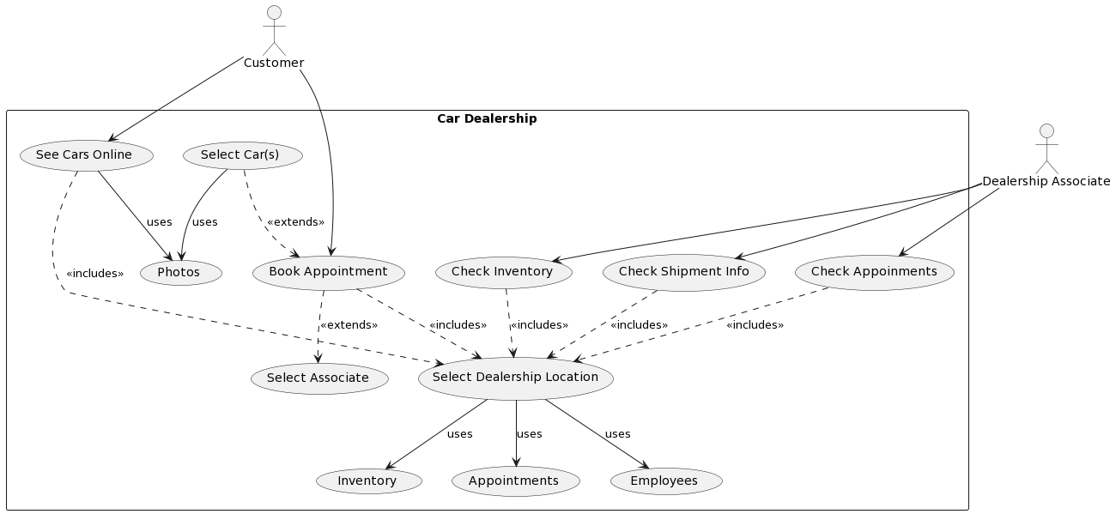
UML Use Case Diagram

Slide 5
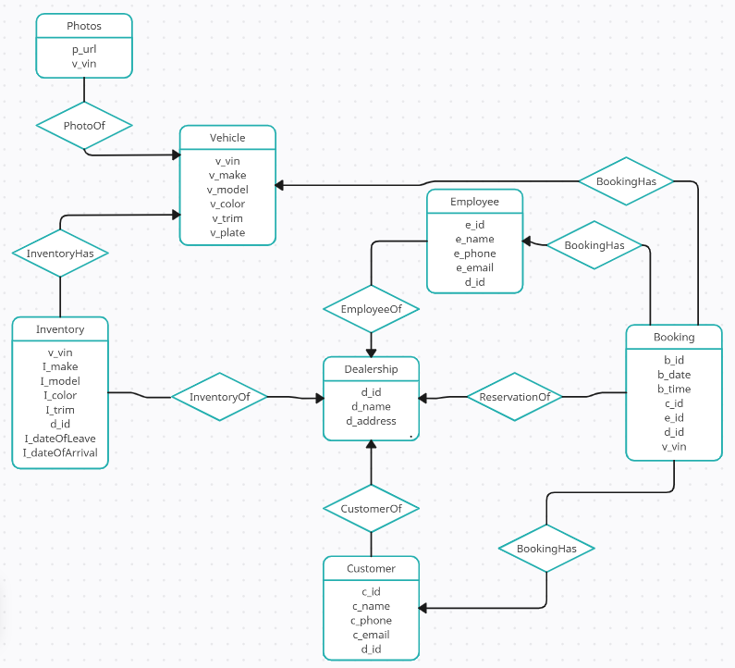
E/R Diagram

Slide 6
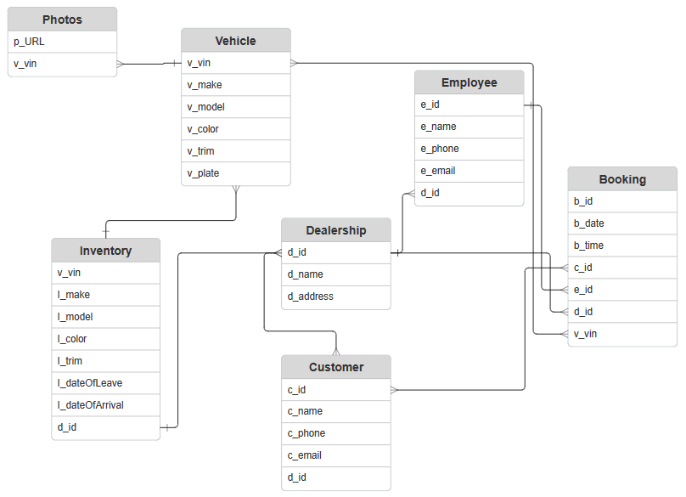
Relational Schema

Slide 7




Implementation Details
Backend/Database:
SQLite3
Storing the databases
Frontend:
React
Components of Website
Framework:
Flask
To help connect frontend with backend
Languages: SQL, HTML, JS, CSS, Python

Slide 8

Thank You For Your Time!

